Slide 1
Session 2: Lecture 1: Antigen recognition OVERVIEW OF ANTIBODIES AND COMPLEMENT
Infection and Immunity
Dr. Sherko Subhan Niranji

Slide 2
LEARNING OUTCOMES
To understand the basic structure and classification of antibodies.
To recognise the functions of antibodies and how different regions within the antibody molecule subserve these roles with special reference to their role as antigen receptors.
To understand the common features of all three complement pathways, how they can be triggered and controlled
(self-study) To appreciate the way in which the immense diversity of antibody specificities is determined.
(self-study) To follow the events involving B lymphocytes subsequent to antigen capture.

Slide 3
ANTIBODIES - WHERE ARE THEY MADE?
Antibodies are synthesised by B lymphocytes.
T lymphocytes do not make antibodies.
Antibodies exist in 2 forms - either membrane bound or secreted.
B lymphocytes use membrane bound antibody to interact with antigens i.e. membrane bound immunoglobulin acts as the B cell antigen receptor.
A B cell makes antibodies all of the same specificity i.e. able to react with the same antigenic determinants, and its progeny (as a consequence of mitotic division) are referred to as a clone.
The clone will continue making antibody of the same specificity.
Simultaneously, there will be lots of other clones of different specificities. This is known as a polyclonal response.

Slide 4
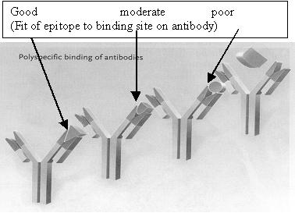
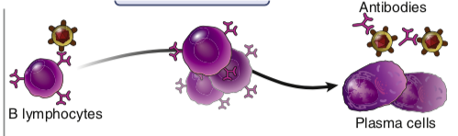
Antigens have determinants called epitopes.
Epitopes are molecular shapes recognized by antibodies, each of which recognises 1 epitope rather than whole antigen.
Antigens may be proteins, lipids or carbohydrates, and an antigen may consist of many different epitopes, and/or may have many repeated epitopes, see figure.
Following antigenic stimulation, B lymphocytes evolve into plasma cells under the influence of T cell released cytokines. Plasma cells secrete antibodies in greater amounts, but do not divide. They exist in lymphoid tissues, not blood. Other B cells circulate as memory cells.

Slide 5
THE LIFE OF THE B CELL
B lymphocytes are formed within the bone marrow and undergo their development there. They have the following functions:
ANTIGEN RECEPTORS - to interact with antigenic epitopes, using their membrane bound immunoglobulin molecules.
ANTIBODY SECRETION - subsequent upon development into plasma cells.
MEMORY CELLS - some circulating B cells are long lived and thus retain memory for previously encountered antigenic epitopes .
ANTIGEN PRESENTING CELLS - consequent upon internalisation and processing of the original antigen, antigen derived peptides are presented to T cells (this will be explained later in the course).

Slide 6
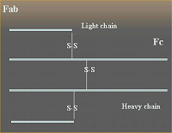
ANTIBODIES - WHAT ARE THEY?
Antibodies are specialised proteins which confer immunity to infections.
BASIC STRUCTURE AND CLASSIFICATION (see figures 1-7 incl.)
Antibodies (Immunoglobulins, abbreviated Ig) are proteins of molecular weight 150,000 - 900,000 kd.
They are unique molecules, derived from the 'immunoglobulin supergene'. One end of the Ig binds to antigens (the Fab portion, so called because it is the fragment of the molecule which is antigen binding), and the other end, which is crystallizable, and therefore called Fc, is responsible for effector functions. As an example of Ig structure, let us look at an IgG molecule.
Figure 1. Basic structure of antibody molecule

Slide 7
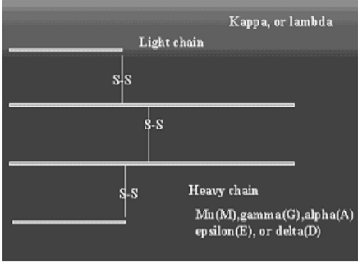
Figure 2. Classes of heavy and light chains
The basic (monomeric) immunoglobulin molecule consists of two light chains (L), each of approximate molecular weight 25,000, and two heavy chains (H), each of approximate molecular weight 50,000. L chains are separated from H chains by disulphide links (S-S).
Intrachain S-S links divide H and L chains into domains which are separately folded.
Thus, an IgG molecule contains 3 H chain domains, written CH¹, CH² and CH³. Between CH¹ and CH², there are many cysteine and proline residues. This is known as the hinge region and confers flexibility to the Fab arms of the Ig molecule. This comes into play when the Ig molecule interacts with antigen.

Slide 8
By submitting an antibody molecule to proteolytic cleavage, it was possible to ascertain what was the function of its component parts. Each Fab was found to be capable of binding to an antigenic epitope, but because it was univalent, could not cross-link epitopes. The Fc fragment was found to possess the effector functions. F (ab')2 fragments are divalent, and able to cross-link antigenic epitopes.
Heavy and light chains are composed of amino-acid sequences, which in those domains of the molecule involved in antigen binding, are found to be extremely variable between individual molecules, but which in the domains involved in mediating effector functions, are relatively constant. The sequence making up the hypervariable region of Fab, the progeny of a single clone of dividing B cells, is identical, and constitutes its so-called idiotype. Thus the idiotype will be likely to differ between different clones, even when they are of the same class.
There are five classes of Ig, IgM, IgG, IgA, IgD and IgE, their differences existing in their H chain constant regions. Another name for class type, is isotype. In some cases isotypes are further divided into sub-types, there being 4 in the case of IgG (IgG1, IgG2, IgG3 and IgG4), and 2 in the case of IgA. There is only a single isotype for IgM, IgD, and IgE.
There are also two classes of L chains, termed lambda, and kappa. An individual Ig molecule only includes L chains (both identical) of one class, though we all possess Ig molecules which are made of either.

Slide 9
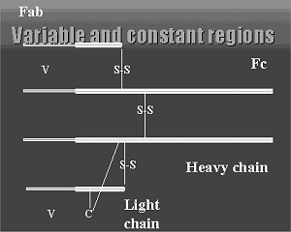
Figure 3 Variable and constant regions

Slide 10
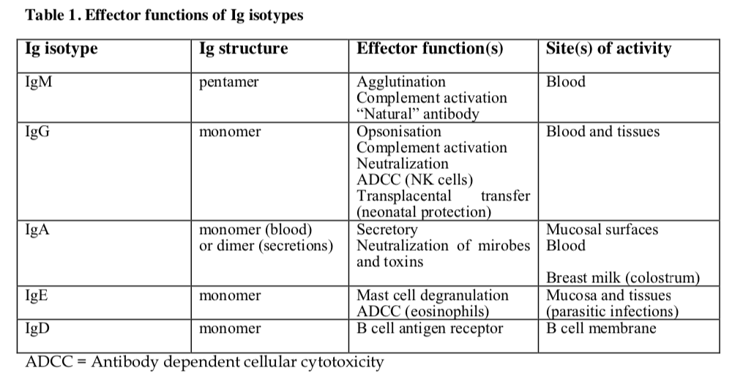

Slide 11
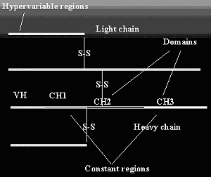
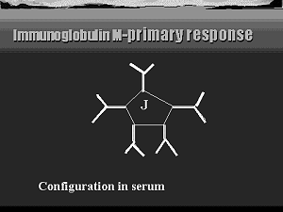
Figure 5. Pentameric structure of IgM
IgM exists in monomeric or pentameric form, IgA in monomeric or dimeric form, and the others only as monomers. Linkage between monomers is effected by means of a J chain (see fig. 5). The constitution of all the isotypes is shown in table 2.
Figure 4. Domains and hypervariable regions
Light chains consist of a single variable and single constant domain. Heavy chains have a single variable domain and 3 (4 in the case of IgE) constant domains

Slide 12
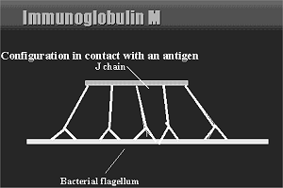
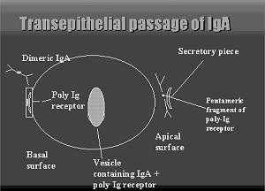
Figure 7 Secreted IgA
Figure 6. IgM interacting with antigen:
On interaction with antigen, IgM undergoes a conformational change that allows it to activate complement.
IgA is the principal Ig found in secretions, e.g. gastro-intestinal, respiratory, and genito-urinary mucus. It protects by preventing organisms gaining attachment to mucous membranes. It is also found in the blood stream however. As the IgA molecule passes into an epithelial cell from the blood stream, it receives an additional structure termed secretory piece syn. secretory component. This serves to transport it through the cell, and remains attached to the IgA at the mucosal surface.

Slide 13
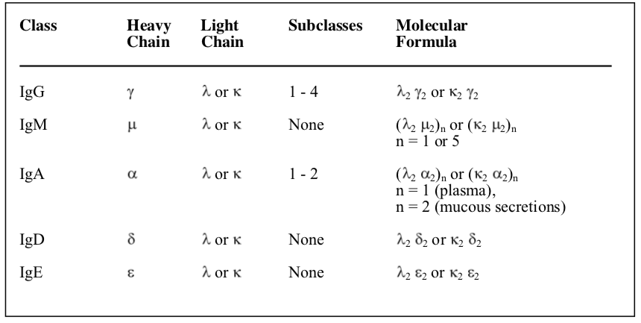
TABLE 2. Composition of the chains in the five human immunoglobulin classes.

Slide 14

Our knowledge of the manner by which a very wide range of diversity of antibody specifities is produced, is a relatively recent feat of biological research.
The process depends upon genetic rearrangements of genomic DNA, separately for light and heavy chains, within each B lymphocyte. Light chain DNA in humans is encoded on chromosome 22 (for λ chain), and chromosome 2 (𝜅 chain), whilst heavy chain DNA is on chromosome 14

Slide 15
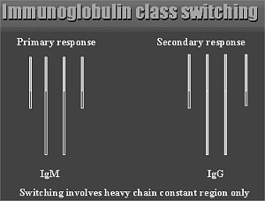
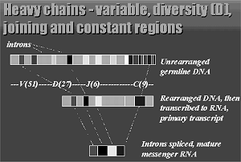
Figure 8. Diagram indicates colour change in heavy chain constant region only
Variable regions are not changed
Figure 9. Diversity in heavy chains

Slide 16
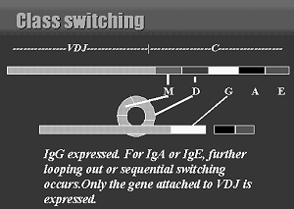
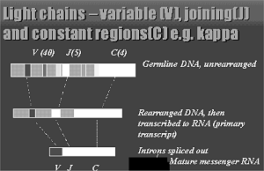
Figure 11. Diversity in light chains
Figure 10. Looping out of unexpressed DNA

Slide 17
Genetic rearrangements are brought about by somatic recombination of germline DNA, see figure 9. In the case of light chains, V region genes re-combine with J (joining) genes, see figure before the VJ segment is joined to the C segment. Next transcription occurs, a primary RNA transcript being formed. Splicing (removal of introns) takes place, resulting in mRNA. This then undergoes translation, resulting in the polypeptide chain of the light chain. In the case of the heavy chain, there is an additional variable segment termed the diversity (D) region. This is interposed with the J region between the V and C regions, see figure. The same process takes place, culminating in translation of the H chain. The heavy and light chains then undergo joining, resulting in a complete immunoglobulin molecule. There is also a gene segment determining whether the immunoglobulin is to be membrane bound or secreted. Allelic exclusion operates, i.e. each cell only utilises the chromosomes of one of the subject's parents. From the numbers of genes involved, see Table 3, we can calculate the number of possible combinations which could, in theory, result in different antibodies, realising of course that the specificity is confined to the variable region of the immunoglobulin molecule. However, the number of specificities is in fact far greater. This is brought about by several processes, namely:

Slide 18
1. Combinatorial diversity
From the table, we see that for k light chains, we have 40 alternative V gene segments, and with 5 J region segments, we have 200 V k regions. For λ, the corresponding numbers are 29 and 4 = 116 Vλ. Thus 316 different light chains could be made. In the case of heavy chains, 51 VH gene segments, 27 DH and 6 JH could result in 51 x 27 x 6 = 8262 combinations. Since variable regions of light and heavy chains independently contribute to antibody specificity, the number of permutations is therefore:
316 x 8262 = 2.5 x 10⁶.
In practice, there are fewer than this, since not all V gene segments are utilised with equal frequency, and not all VH and VL regions will pair successfully.
2. Junctional diversity
This takes place in the 3rd hypervariable region (V-J, for light chains, and D-J, for heavy chains), resulting from the enzymically mediated insertion of nucleotides at these joining sites, thus altering the resultant specificity, and increasing the potential number of specificities.

Slide 19
3. Somatic hypermutation
Antigenically stimulated B cells are more liable to undergo point mutation in the variable regions of rearranged H and L chain genes, resulting in the appearance of mutant immunoglobulin molecules on the surface of the B cell able to interact with antigen. As a consequence of the mutational event, the antibody specificity may be altered, conferring greater or lesser affinity. If greater, then that cell is more likely to be stimulated to divide, in turn leading to an increase in affinity of secreted antibody. This is known as affinity maturation of antibody during an ongoing immune response.
B cells re-arrange their immunoglobulin genes as if their lives depend on it - which they do! First heavy chain and then light chain genes are re-arranged, and transcribed. A B cell in which only the heavy chain genes have undergone transcription is a pre-B cell, after which, with the addition of the light chain, it becomes a mature B cell, equipped with an antigen receptor. Failure to achieve this results in the death of the cell.

Slide 20
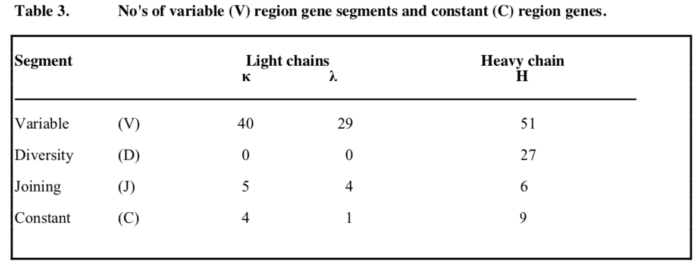

Slide 21
SUBSEQUENT EVENTS
Secreted antibodies bind to circulating antigen, forming immune complexes. Some complexes will activate complement. The complexes are trapped by follicular dendritic cells (FDC‟s) in lymph nodes, because these cells possess receptors for Fc of IgG and C3b.These events take place in the germinal centers. The surface membrane of the FDC‟s may bud off, complete with attached immune-complex. These structures are termed iccosomes. Their purpose is to present the original antigen to B cells bearing high affinity surface immunoglobulin. These B cells are destined to survive, and develop into memory B cells or into immunoglobulin secreting plasma cells. B cells with low affinity antibody will die by apoptosis. The survival of B cells with high affinity immunoglobulin is conferred by helper T cells (CD4+) interacting with B cell-presented peptide, derived from the original antigen, because the B cell‟s immunoglobulin receptor for that antigen was of sufficiently high affinity. CD40 ligand on the T cell interacts with CD40 on the B cell, as a consequence of which the signal to make Bcl-xL protein is given. This prevents the sequence of events which otherwise would lead to the apoptotic demise of the B cell. Doomed B cells are phagocytosed by macrophages in the germinal centres. They are then called tingible body macrophages.

Slide 22
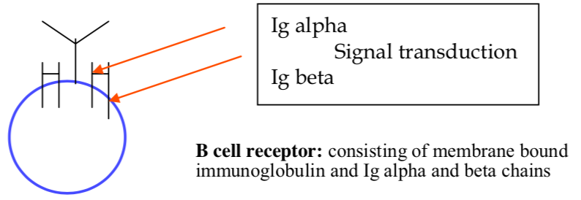
Membrane bound antibody is part of the B cell receptor complex (BCR), consisting of the membrane bound immunoglobulin and several invariant protein chains. Together with the Ig they constitute a disulphide linked hetero-dimeric complex. They are involved both in expression of membrane bound Ig and in signal transduction, see figure.

Slide 23
POINTS TO REMEMBER
Antibodies have exquisite specificity for antigenic determinants. The large number of specificities is achieved by a combination of germ line gene segments, plus somatic hypermutation of antigenically challenged B lymphocytes.
IgM is the predominant antibody of the primary response, and IgG of the secondary response. The secondary response is more rapid in onset after challenge, of greater magnitude, and the antibody is of higher affinity, and longer duration in the circulation.
IgA is the antibody, which confers immune protection at mucosal surfaces. It is present in secretions.
Membrane bound immunoglobulins function as antigen receptors on B lymphocytes. With help from T lymphocytes, B cells differentiate into plasma cells (found within lymphoid tissues), and secrete antibodies into the circulation.

Slide 24
COMPLEMENT, OPSONISATION AND PHAGOCYTOSIS
Opsonisation
Opsonisation is the process of coating micro-organisms with certain plasma proteins to increase their adherence to phagocytic cells in preparation for phagocytosis. The two main opsonins are IgG antibody, and the third component of complement (C3), which bind directly to the surfaces of micro-organisms. Phagocytic cells have membrane receptors for IgG (Fc portion) and activated C3 (which is called C3b). IgG antibody binds to micro-organisms because the Fab portion recognises bacterial epitopes. C3b binds because during activation of C3 a thiol bond is exposed which permits the formation of ester or amide bonds (covalent binding) with the bacterial surface structures. Opsonisation of a pathogen by IgG or C3 therefore acts as an aid to phagocytosis (see Session 1) and killing of the micro-organism.

Slide 25
COMPLEMENT
What is complement? It is cascade of proteases, culminating in a membrane attack complex (MAC) which damages the pathogen by pore formation and osmotic pressure. Complement components are numbered 1-9. MAC utilizes C5-C9. It is a serum constituent which complements the action of specific antibody in killing bacteria or eukaryotic cells. It is present in fresh serum, but is destroyed by heating to 56oC for 30 minutes.
Why is it called complement?
Complement got its name when it was discovered that antibody plus something in fresh serum could kill pathogens. The “something” in serum complemented the action of antibody, hence it was called complement.
How does complement kill organisms? It does so by the membrane attack complex (MAC). The final components of the complement cascade (named C5 to C9 inclusive) form pores in the target. C9 is the transmembrane pore, which resembles the perforin found in lytic granules of cytotoxic CD8+ cytotoxic T cells (which kill viruses). Thus bacteria and eukaryotic cells are killed by the transmembrane pore C9, whereas viruses are killed by the transmembrane pore of the lytic granules of cytotoxic T cells.

Slide 26
How is complement activated?
The typical description of the process is given below, but a simplified scheme has been devised, and follows afterwards.
Pathways for complement activation
C3 is activated by limited proteolysis by enzymes called C3 convertases. There are two C3 convertases, one produced by activation of the classical pathway which is antibody dependent (IgM or IgG), while the alternative pathway can be activated in the absence of antibody. The classical pathway is activated when the C1q subcomponent of first component of complement binds to two adjacent IgG molecules or a single IgM molecule. The C1s subcomponent of C1 becomes an active protease and activates C4 and C2 to form the classical pathway C3 convertase which is a complex of activated C4 (C4b) and C2 (C2a). It is designated C4b2a. The alternative pathway is activated when micro-organisms come into contact with body fluids. The pathway is always being activated slowly to generate small amounts of activated C3 (C3b). The initial turnover of the alternative pathway is believed to be stimulated by the low-grade hydrolysis of the thiolester of C3 to form a C3b-like molecule (C3(H2O)), which can bind B and form a low efficiency C3 convertase (C3(H2O)Bb) which is relatively resistant to the actions of factors H and I. When C3b binds to a micro-organism activation of the alternative pathway is amplified so that a large amount of the alternative pathway C3 convertase is formed on the surface, followed by deposition of activated C3 (C3b).

Slide 27
There is now known to be a third complement activating pathway, the lectin pathway, in which mannose binding lectin (MBL; an analogue of C1q) binds directly to mannose residues on micro-organisms in the absence of antibody. There are three enzymes associated with MBL, (called MASP = MBL associated serine protease) MASP-1, MASP-2 and MASP-3 which are analogous to C1r and C1s. Activation of MASP-2 following the binding of MBL to bacteria leads to activation of C4 and C2 as in the classical pathway. Thus there are two complement pathways which are part of the innate immune system, the lectin pathway and the alternative pathway, and one that requires antibody (the classical pathway).
Once C3b has been formed (by activation of any of the three pathways) some binds to the C3 convertase to change it to a C5 convertase which activates C5 to form C5b. Subsequently C6, C7, C8 and C9 bind together with C5b to form a complex (C5b-9 complex; membrane attack complex) which is inserted into cell membranes to produce lysis.

Slide 28
Thus complement kills micro-organisms in two ways:
1. Opsonisation (C3b) followed by phagocytosis and intracellular killing (indirect).
2. Assembly of the cytolytic C5b-9 membrane attack complex (direct).
WHY IS COMPLEMENT SO COMPLICATED
Because various components were discovered at different times and numbered chronologically when discovered. Thus there is a non-sequential numbering when describing what occurs sequentially.

Slide 29
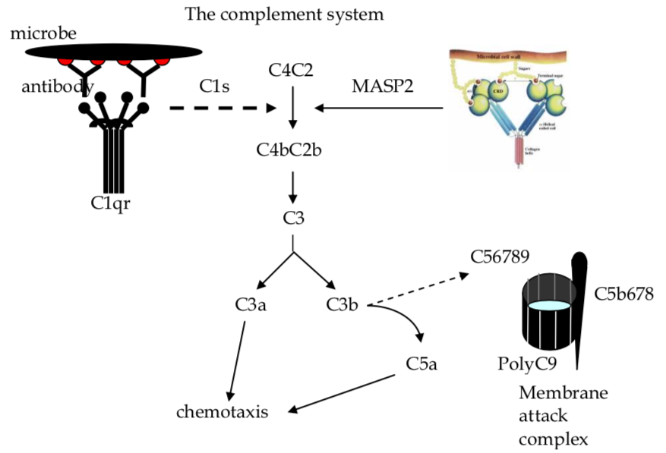

Slide 30
Lecture 2
ANTIGEN PROCESSING AND PRESENTATION – HOW T CELLS RECOGNISE PATHOGENS

Slide 31
LEARNING OUTCOMES
The lecture will give an introduction to T cells, the major effector cells involved in acquired cell mediated immunity, show how they develop, and the processes by which they recognise and respond to antigen.
By the end of the lecture the student should understand:
The major sub-populations of T lymphocytes involved in the immune response to infection.
The mechanisms by which T lymphocytes recognise antigens.
The role of the major histocompatibility complex (MHC) in antigen recognition by T cells.
The role of the thymus in the ontogeny of T lymphocytes.
The role of professional antigen presenting cells in T cell activation and generation of the immune response

Slide 32
Introduction to T lymphocytes
The main effector cells involved in acquired cell mediated immunity are T lymphocytes. T lymphocytes play a major role in defence against intracellular pathogens such as viruses, protozoa and intracellular bacteria (“cell mediated immunity”), and in immunity to extracellular pathogens by providing “help” for the antibody response (“humoral immunity”). The lecture will provide a general introduction to the biology and development of T lymphocytes, and will describe how T cells recognise antigens and the role of MHC molecules in antigen recognition. Finally, the interaction of naïve T cells and professional antigen presenting cells will be described in the triggering of the adaptive immune response.
In the periphery, mature T cells can be divided into several subpopulations, based on the expression of different cell surface marker molecules (see Fig.1).

Slide 33
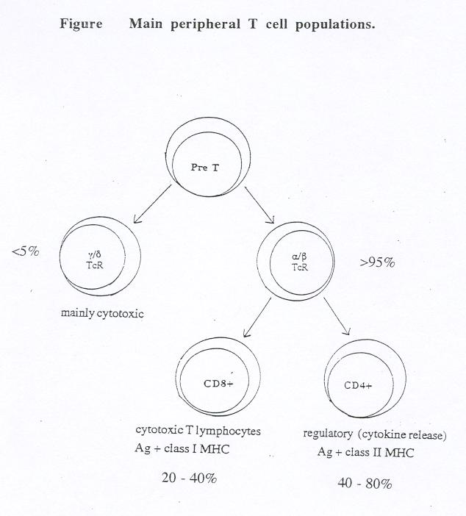

Slide 34
Like B cells, T lymphocytes express an antigen specific surface receptor. Expression of the T cell antigen receptor (TcR) confers antigen specificity to the T cell.
The nature of the TcR is distinct from the antigen receptor (membrane- bound immunoglobulin) on B lymphocytes, but the huge diversity of specificities of TcR expressed within the T cell repertoire is achieved by a similar process of TcR gene rearrangement of V (variable), D (diversity), J (joining) and C (constant) gene segments. This combinatorial diversity maximises the number of antigen specificities in the T cell repertoire that are encoded by the germ line genes.
As with B cells, individual antigens are recognized by clones of T cells, whose antigen-specific receptors recognize specific epitopes within the antigen.
Unlike immunoglobulin and B cells, the TcR is found only in a membrane bound form, and does not undergo class switching or somatic hypermutation during the immune response.

Slide 35
There are two forms of TcR - the great majority of T cells in the periphery (>90%) express α/β TcR, whilst a minority of T cells (<10%) express γ/δ TcR (the Greek letters refer to the polypeptide chains from which the TcR are formed). γ/δ T cells represent a more primitive form of T cells in evolutionary terms than α/β T cells. γ/δ T cells become activated during infection, but their role in the immune response appears non-essential in most forms of infection.
The main functions of γ/δ T cells are cytokine secretion and cytotoxicity. γ/δ T cells will not be discussed further in the course. Peripheral α/β TcR positive cells express either the CD4 or the CD8 surface marker, and these markers can be used to define the major subpopulations of mature T cells in the periphery.
In broad terms, the CD4+ T lymphocytes represent the “helper” T cell population (involved in cytokine production and coordination of the immune response), whilst the CD8+ T lymphocytes represent cytotoxic T lymphocytes (CTL), which kill cells that are infected with intracellular pathogens such as viruses, some intracellular bacteria (eg Listeria) and some intracellular protozoa (eg malaria parasites).
All T cells also express a surface molecule called CD3. Expression of the CD3 surface marker is specific for T lymphocytes, and is often used to characterise T cells.
In contrast to immunoglobulin on B cells or soluble antibody molecules, T cell receptors do not recognise free soluble or surface bound antigen, but require the antigen to be processed and presented by an antigen presenting cell (APC). T lymphocytes (via their TcR) recognise antigen in the form of short peptides presented in association with “self” major histocompatibility complex (MHC) class I or class II molecules at the surface of the antigen presenting cell (see Figure 2).

Slide 36
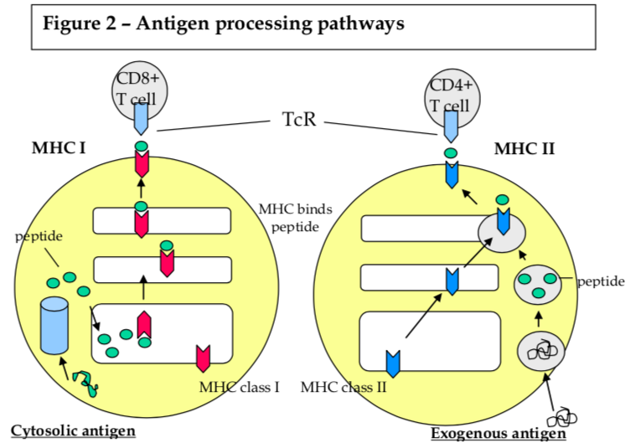

Slide 37
This phenomenon is known as MHC restriction of T lymphocyte responses. Students should familiarise themselves with the MHC (in man termed HLA, for Human Leukocyte Antigen), and the role of MHC molecules in antigen presentation to T lymphocytes.
In humans, there are three MHC class I genes, HLA -A, -B and –C, and three MHC class II genes, HLA - DR, -DP and -DQ. These genes are highly polymorphic, and each individual inherits 2 copies of each gene. The degree of polymorphism at each gene locus is such that most individuals will express genes encoding 6 different HLA class I molecules (ie 2x -A; 2x -B and 2x -C), and 6 different HLA class II molecules (2x -DR, 2x -DP and 2x -DQ). Different HLA molecules bind a different set of peptides, so the polymorphism within MHC genes maximises the number of different (antigenic) peptides that can be presented to an individual‟s T cells. In addition to their roles as antigen presenting molecules, HLA molecules represent the main antigenic targets in organ graft rejection (where these are not matched between organ recipient and donor), and some HLA molecules are associated with increased susceptibility to specific diseases (for example, HLA-B27 and ankylosing spondylitis; see Session 9).

Slide 38
As shown in Figure 2, T cell recognition of antigen involves direct cell-cell contact between the antigen-
specific TcR on the T lymphocyte and an MHC/peptide complex at the surface of a MHC compatible antigen presenting cell. In general, class I MHC molecules present antigen to CD8+ T cells, and class II MHC molecules present antigen to CD4+ T cells. Class I MHC molecules are expressed constitutively on almost all nucleated cells of the body, whilst constitutive expression of class II MHC molecules is restricted to certain cells of the immune system, collectively known as professional antigen presenting cells, - B cells, macrophages and dendritic cells - although expression of class II MHC may be induced on other cell types at sites of inflammation. There are distinct pathways of processing of antigen for presentation in association with class I and class II MHC molecules (see Figure 2).
Antigens bound for presentation in association with MHC class I molecules are derived from the cell‟s cytosol, and are usually endogenously synthesized within the cell (for instance, viral antigens). In contrast, the majority of antigens that are presented by MHC class II molecules are derived from exogenous antigens, such as soluble proteins or extracellular organisms.

Slide 39
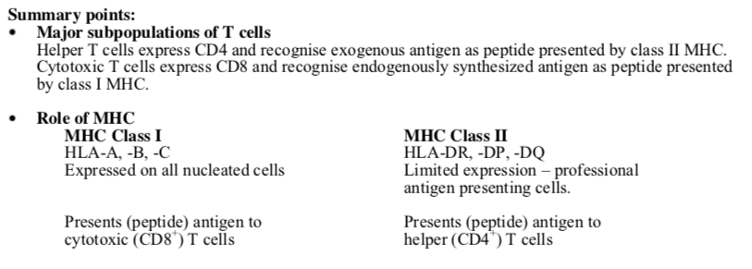

Slide 40
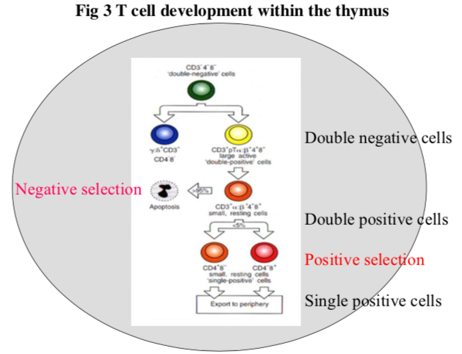

Slide 41
Self and non-self recognition – the role of the thymus
T lymphocytes are so called because of the role that the Thymus gland plays in their development. Pre-T lymphocytes arise from stem cells in the bone marrow, and must migrate through the thymus in order to develop into mature, functional T cells capable of responding to antigen in the periphery. The immature T lymphocytes are known as thymocytes during their differentiation and migration through the thymus. Intra-thymic maturation of T cells involves several distinct phases, including differentiation and maturation, expression of the T cell antigen receptor (TcR), and negative and positive selection (see Fig 3).
The process of negative selection is designed to delete T cells whose antigen receptors recognize self antigens with high affinity, and would therefore be autoreactive if released into the periphery (ie negative selection is the main mechanism by which self tolerance is achieved), whilst positive selection ensures that cells capable of recognizing “foreign” antigens survive and differentiate further. Only T cells that survive these phases are released from the thymus as mature, antigen reactive T cells. Thus the processes of positive and negative selection of T cells within the thymus are the basis of self and non-self discrimination by the adaptive immune response, by ensuring the potentially autoreactive T cells are not released into the periphery.

Slide 42
Cell co-operation in the immune response
The antigen-specific adaptive immune response takes several days to develop, due to the need for clonal selection, differentiation and expansion of antigen-specific effectors. The adaptive immune response to infection involves both the T and B cell mediated compartments of the immune system. The integrity of the adaptive immune system is based on the ability of lymphocytes to recirculate between the blood and lymphoid tissues, and for activated effector cells to migrate into the somatic tissues at sites of infection. The response can be separated into distinct phases:
1) The induction phase occurs principally in the lymphoid tissues. Antigen either finds its own way to lymphoid tissues (e.g. antigen in the circulation passing through the spleen or in the afferent lymph entering lymph nodes) or (more commonly) it is transported to lymphoid tissues by migratory dendritic cells. Dendritic cells represent the main type of professional antigen presenting cell in the induction of the immune response.

Slide 43
They are found in the periphery as immature DCs, and after capture of antigen in the periphery they migrate to regional lymph nodes, where they process the antigen and “mature” into cells capable of activating naïve antigen-specific T cells. In order to stimulate a naïve T cell, two signals are required. Recognition of an antigen/MHC complex by the T cell‟s TcR provides the first signal. The second signal is provided by the interaction of surface molecules on the T cell and the antigen presenting cell (also known as “costimulation”). Only professional antigen presenting cells express the molecules that provide costimulatory signals to T cells, and therefore only professional antigen presenting cells, presenting the appropriate antigenic peptide, can initiate a T cell response. Naïve T cells that encounter antigen without receiving a costimulatory signal become anergised (unresponsive) to further antigen presentation. This provides a further mechanism of tolerance to self-antigens (as antigen presentation outside of lymphoid tissues usually lacks costimulation). In addition to mediating activation of the adaptive immune response, professional antigen presenting cells play a major role in determining the type of immune response produced, for example by influencing the balance between Th1 and Th2 cells (discussed in session 3) which biases the outcome towards a cell mediated or humoral (antibody mediated) type of response.

Slide 44
Once a T cell has been activated by antigen presented by a professional antigen presenting cells, it is capable of recognizing the antigen presented by any cell that expresses the same antigen/ MHC complex (ie costimulation is required for activation of naïve T cells, but not for antigen recognition by effector T cells). In this way, induction of the immune response is controlled by professional antigen presenting cells within the lymphoid tissues, whilst effector T cells are then able to respond to antigen presented at distant sites within the body. These requirements for controlling the initiation of the adaptive immune response within the lymphoid tissues regulate its activation, maximise the chances of an antigen-specific T cell encountering its antigen, and reduce the chances of uncontrolled or inappropriate immunological activation.
2) Following activation of antigen-specific lymphocytes in the lymphoid tissues, these cells undergo a process of clonal expansion and differentiation. Some of these cells become activated effector lymphocytes (helper T cells, or cytotoxic T cells), whilst other cells remain in a partially-activated state and recirculate as memory cells. Memory cells have less stringent requirements for activation on re- contact with antigen in terms of additional signals than naïve lymphocytes, and respond more quickly to subsequent exposure to antigen.

Slide 45
3) The effector phase of the immune response involves the activated cells migrating to the site of infection in order to combat the infection within the peripheral tissues. The different sorts of effector cells, and their roles in responses to different types of infection, include the killing of virally infected cells by cytotoxic T lymphocytes, the induction of delayed type hypersensitivity reactions and macrophage activation, or promotion of antibody production by helper T cells. This stage of the immune response also requires considerable co-operation between different cell types, including interactions between antigen- specific and non-specific effector cells, in clearing the infection. The CD4+ T cells play a central role in co-ordinating the antigen-specific immune response, by providing “help”, through cytokine release, for B cells in isotype switching and affinity maturation of antibody responses, for CD8+ T cells in the induction of effector CTL, for enhancement of NK cell function, and for macrophage activation in delayed type hypersensitivity reactions and bacterial and fungal killing (see session 3).
4) Resolution: Ultimately it is left to the non-specific phagocytic cells to clear up the mess, and the macrophages and fibroblasts to resolve any damage caused by the infection and to promote healing. The importance of each component of the immune response in combating infection is demonstrated by the predisposition to infections with particular groups of organisms of individuals with deficiencies in one or more component of the immune response. (See lecture notes on immunodeficiency; Session 3).
Thus, in order to work effectively in response to infections, the different components and cells of the immune system must act co-operatively to eliminate the infecting micro-organisms.

